Slide 1
Final Project
Neural Network Inference on FPGA
ECE 6213
Osama Yousuf, Joseph Riem

Slide 2
Overview
A web server hosts a web camera (USB camera not working with the board)
The PS requests a live image from the web server (current limitation: server is hosted locally)
The web server responds with an image
The image is processed by the PS to match network’s expectations
Localization, Binarization, Reshaping
The processed image is fed to the network on the PL via a DMA send channel
The prediction output of the image is read by the PS via a DMA receive channel
Demo: End-to-end inference with web camera integration

Slide 3
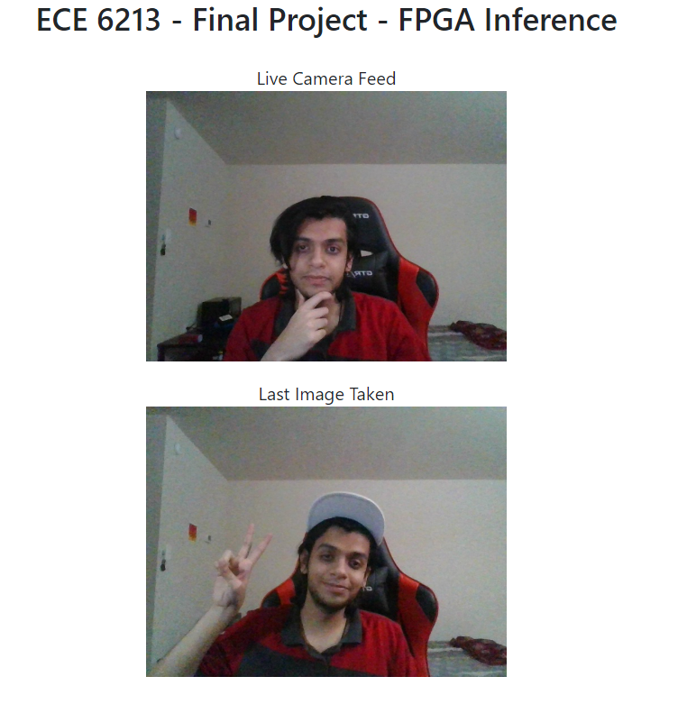
Web Server
A local web server exposes an endpoint for capturing an image
Snapshot of our web server as a workaround for a camera

Slide 4

Web Server
Let’s see it working live!
Code $→$ Start the Web Server $→$ Demonstrate live image capturing
http://192.168.1.152:5000/ - main feed
http://192.168.1.152:5000/capture_image - download current image

Slide 5
Inference on the board!
Let’s see the complete integration now!

Slide 6
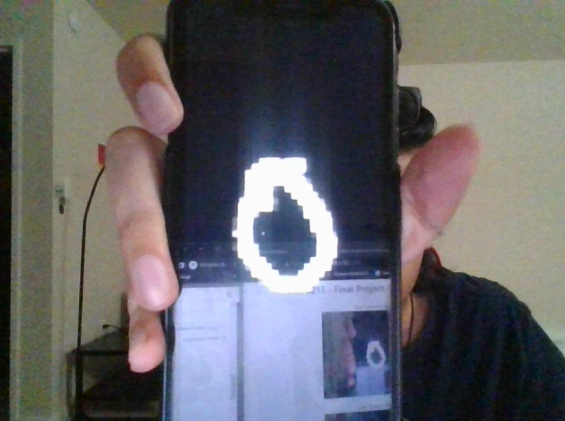
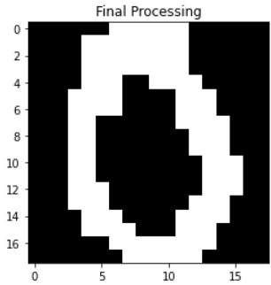
Live Image Before Processing
Live Image After Processing

Slide 7


